Slide 1
Tooth Decay Detection
ITCS-5152 / ITCS-4152
Computer Vision
Team Members:
Adam Stegall,
Aakanksha Chauhan,
Mardi Hach,
Vaishnavi Poondi Chinnappa Narayanan,
Ashish Bisht

Slide 2
How can Computer Vision be applied to tooth decay?
Tooth decay is the most widespread disease in United States
37% of children, 58% of adolescents, 90% of adults
The earlier tooth decay is detected, the more conservative the treatment
X-Rays are visually assessed by dentists to detect tooth decay
Tooth decay shows up as a dark area in digital file
A computer vision program may accelerate analysis, be more consistent, and detect issues the human eye may miss
Additional benefits may be to suggest treatment options
Could be deployed in regions with limited dental access to assist with dental assessment

Slide 3
Research and Current Business Environment
We found limited research about applying computer vision to dental X-Rays
The handful of papers were very recent, suggesting ample academic opportunities
We were only able to find one company specializing in computer vision analysis of dental X-Rays

Slide 4
Obtaining Data
Due to medical privacy issues, sourcing public dental X-rays is difficult
Labeling dental X-rays requires domain knowledge
We were unable to find a dental expert to partner with during limited project timeline
We contacted Dr. Luciano Oliveira, Computer Science professor at Universidade Federal da Bahia (UFBA, Brazil)
Researching “Deep Instance Segmentation of Teeth in Panoramic X-Ray Images”
Granted access to dataset, after signing nonprofit research-only use agreement
The shared dataset did not contain labels for tooth decay, so we altered our project to fit the available labeled data

Slide 5
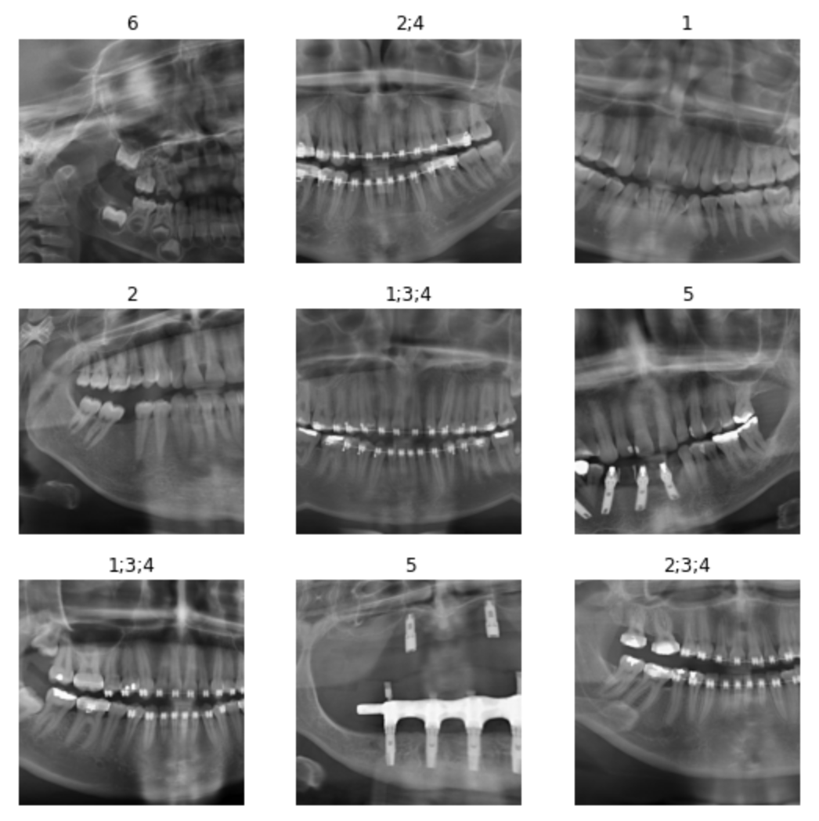
Data: Panoramic Dental Radiographs
The data was organized in 10 different categories:
All teeth with restoration and with a dental appliance
All teeth with restoration and without a dental appliance
All teeth without restoration and with a dental appliance
All teeth without restoration and without a dental appliance
Contains dental implant
More than 32 teeth
Missing teeth with restoration and with dental appliance
Missing teeth with restoration and without dental appliance
Missing teeth without restoration and with dental appliance
Missing teeth without restoration and without dental appliance.
Class ImageDataLoaders was used and item_tfms=Resize() argument was utilized for resizing our images prior to training the model.

Slide 6
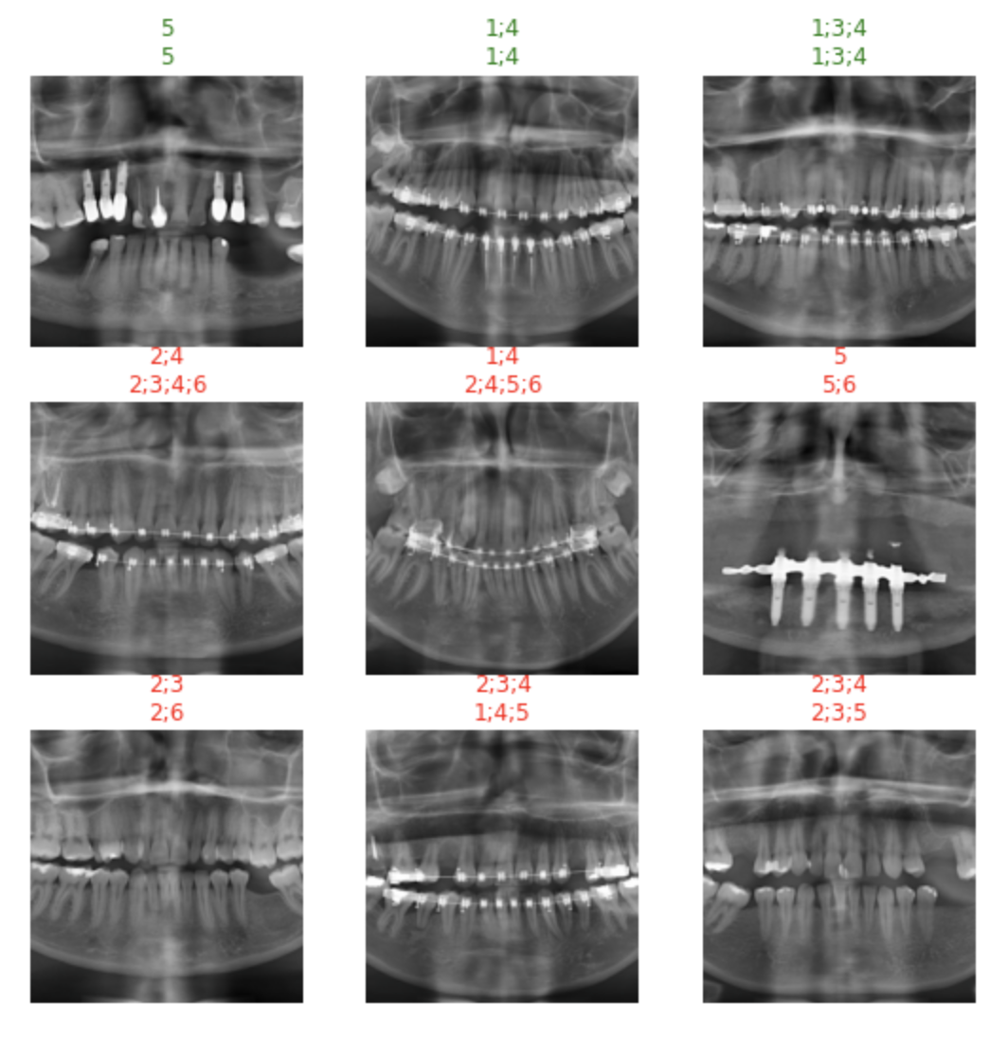
Multi-label Classification of Images: (Training)
The categories were broken down into 6 different labels for the classification of images:
All teeth (32)
Missing teeth (less than 32)
Underwent dental restoration
Contains dental appliance
Contains dental implant
More than 32 teeth

Slide 7
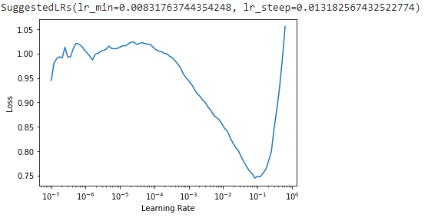
First Model: Residual Neural Network (resnet50)
resnet50: (Residual Neural Network) is a convolutional neural network that is 50 layers deep
This vision model denotes to the idea of adding residual learning to the traditional convolutional neural network
Thereby the model in general tries to tackle the issues of gradient dispersion and accuracy degradation in deep networks

Slide 8
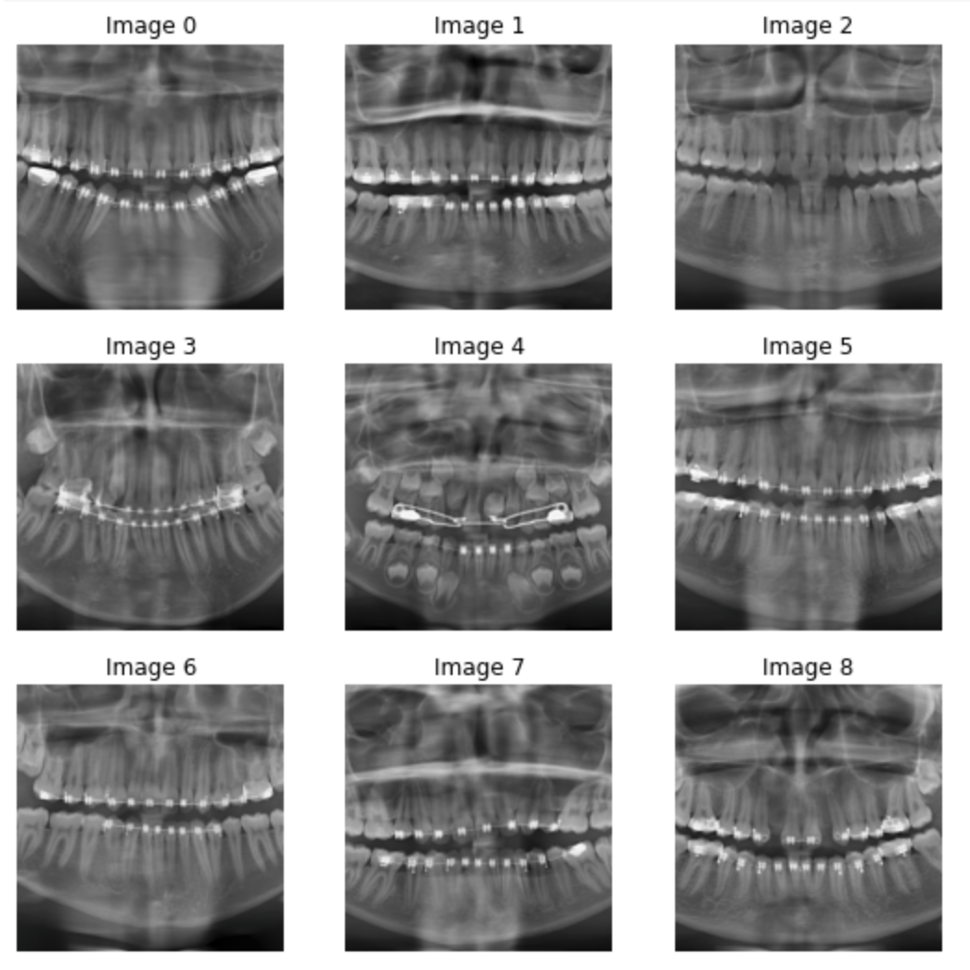
Frames with highest loss:
We identified badly predicted Frames.
These frames with highest Loss is shown in the image.
Further a bash script was used to generate list of frame numbers and Labels.
Those frames were separated from the dataset to see how best the model performed on new data.

Slide 9
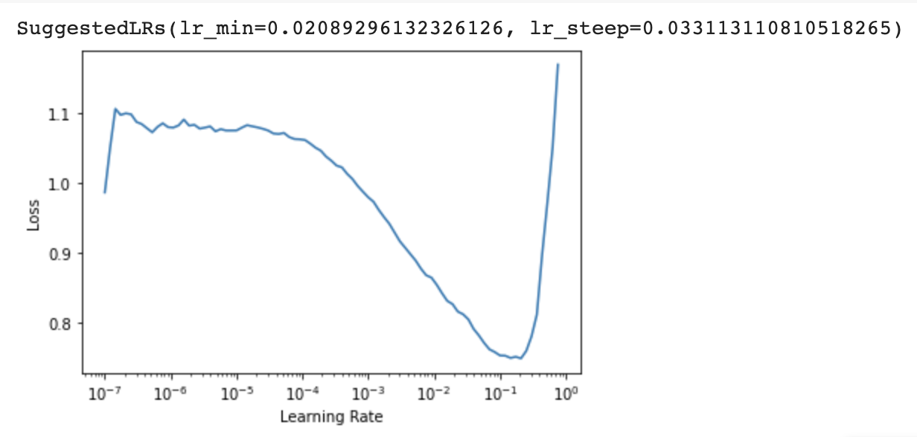
Second Model: Transfer Learning to optimize our Model
Densenet161: (Densely Connected Convolutional Networks) vision model is often used frequently with multi label classification problems
Dense Convolutional Network (DenseNet) connects each layer to every other layer in a feed-forward fashion.

Slide 10
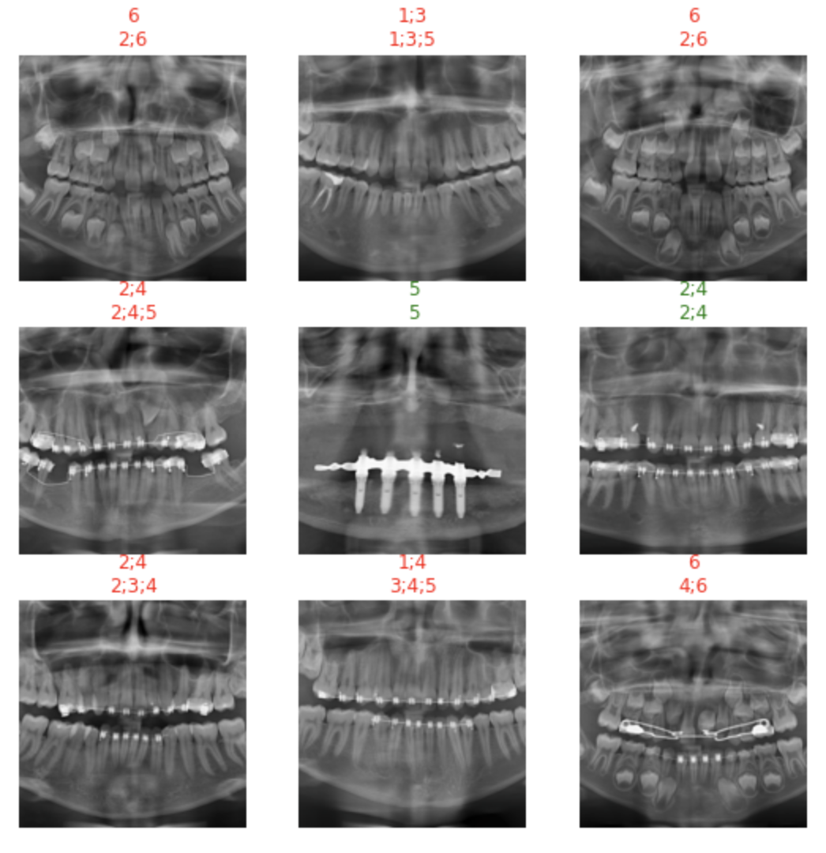
Classification of Images:
Here we are displaying random frames from our model:
# green text=correctly classified
# red text=incorrectly classified

Slide 11
Results:
Accuracy of 73.33% was observed.
Fine tune learning rate of 9e-8 was observed.
Train_loss of 64.99% was observed.
Valid_loss of 58.31% was observed.
With further training and model development, we believe we can improve model.

Slide 12
How could our Computer Vision System be implemented for business or public benefit?
May assist dentist with identifying patient’s problem areas to focus on
Streamline workflow
Could be useful in initial patient assessment in areas with low dental provider access
Given labeled data, may help identifying high risk patients
Prompt dental provider intervention
May identify susceptibility to other conditions
Hyperdontia is condition with more than 32 teeth, often correlates with other conditions
Could help with risk assessment for insurers
May be beneficial in classification of dental records for data management and health analytics
May assist with identifying patterns if other labels provided with data, such as comorbidities, socioeconomic status, ethnography, etc
If present, such correlations may be useful in identifying public health concerns and policy needs

